Slide 1

Better Easier TimeTable
By Franco, Pruthvi, Anas, Romi, Anthony, Philipe, Cameron

Slide 2
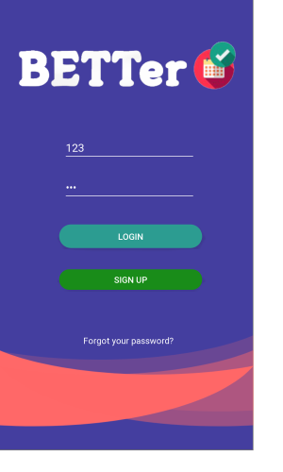
Give Me A Purpose
Ease Of Use
Only Necessary Info
Personalised Data
Simple

Slide 3
Current Features
Put Picture showing a day of the week page here
One Click TimeTable
Lab & Lecture Notifications
Lecture Location Map
Regularly Updated

Slide 4
Visions Of The Future
Put Picture of the map page here
Multi University Compatible
Custom Appointments
Automatic Group Hookup & Messaging
Interactive Map
Academic Tracker
Notepad

